Slide 1
Urban Ecotone
Brooklyn Marine Terminal
Anunya Kasliwal and Sara Shah
Hyperimage Protocols
FA 2025

Slide 2
Manipulate the Pointcloud of the site to be shaped into massing for our new building. This is an exploration project for our studio project
Hyperimage Protocols
FA 2025
FA 2025

Slide 3
ANUNYA:
https://curiouskasu.github.io/f6978d/
Hyperimage Protocols
FA 2025
FA 2025

Slide 4
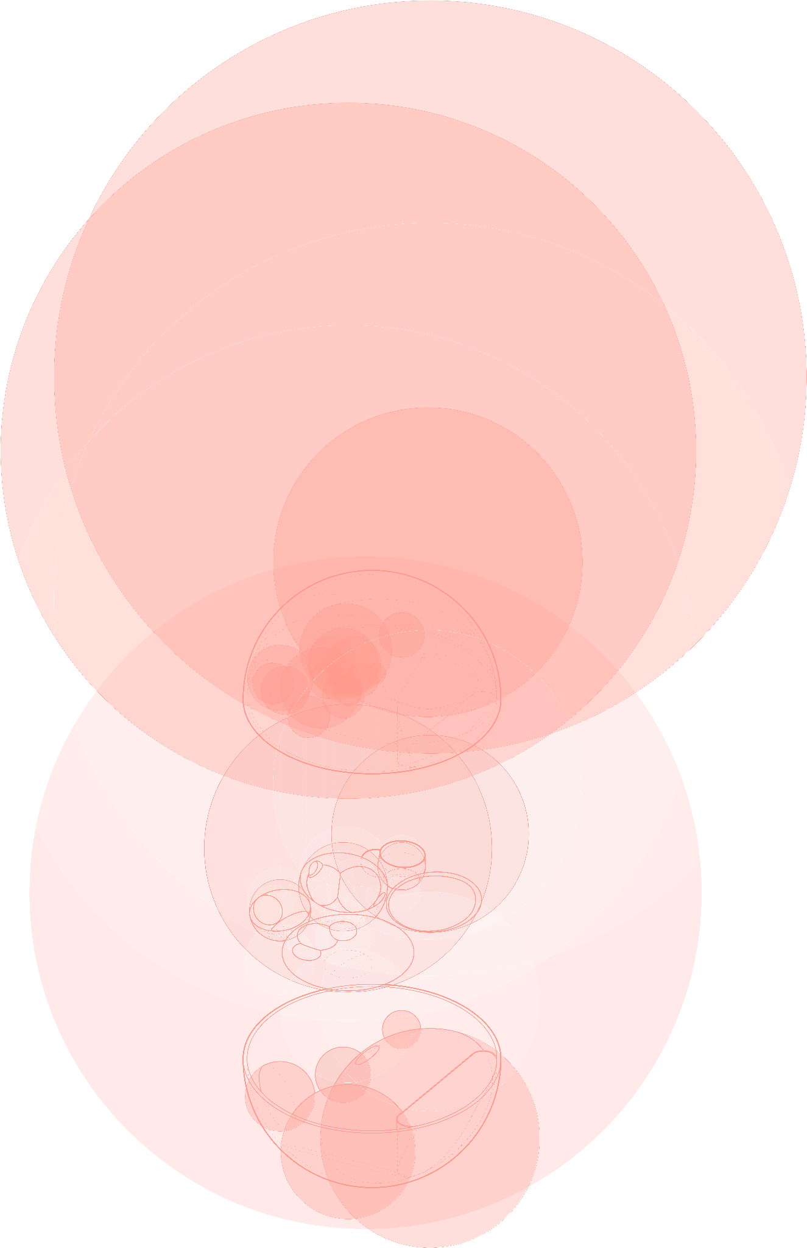
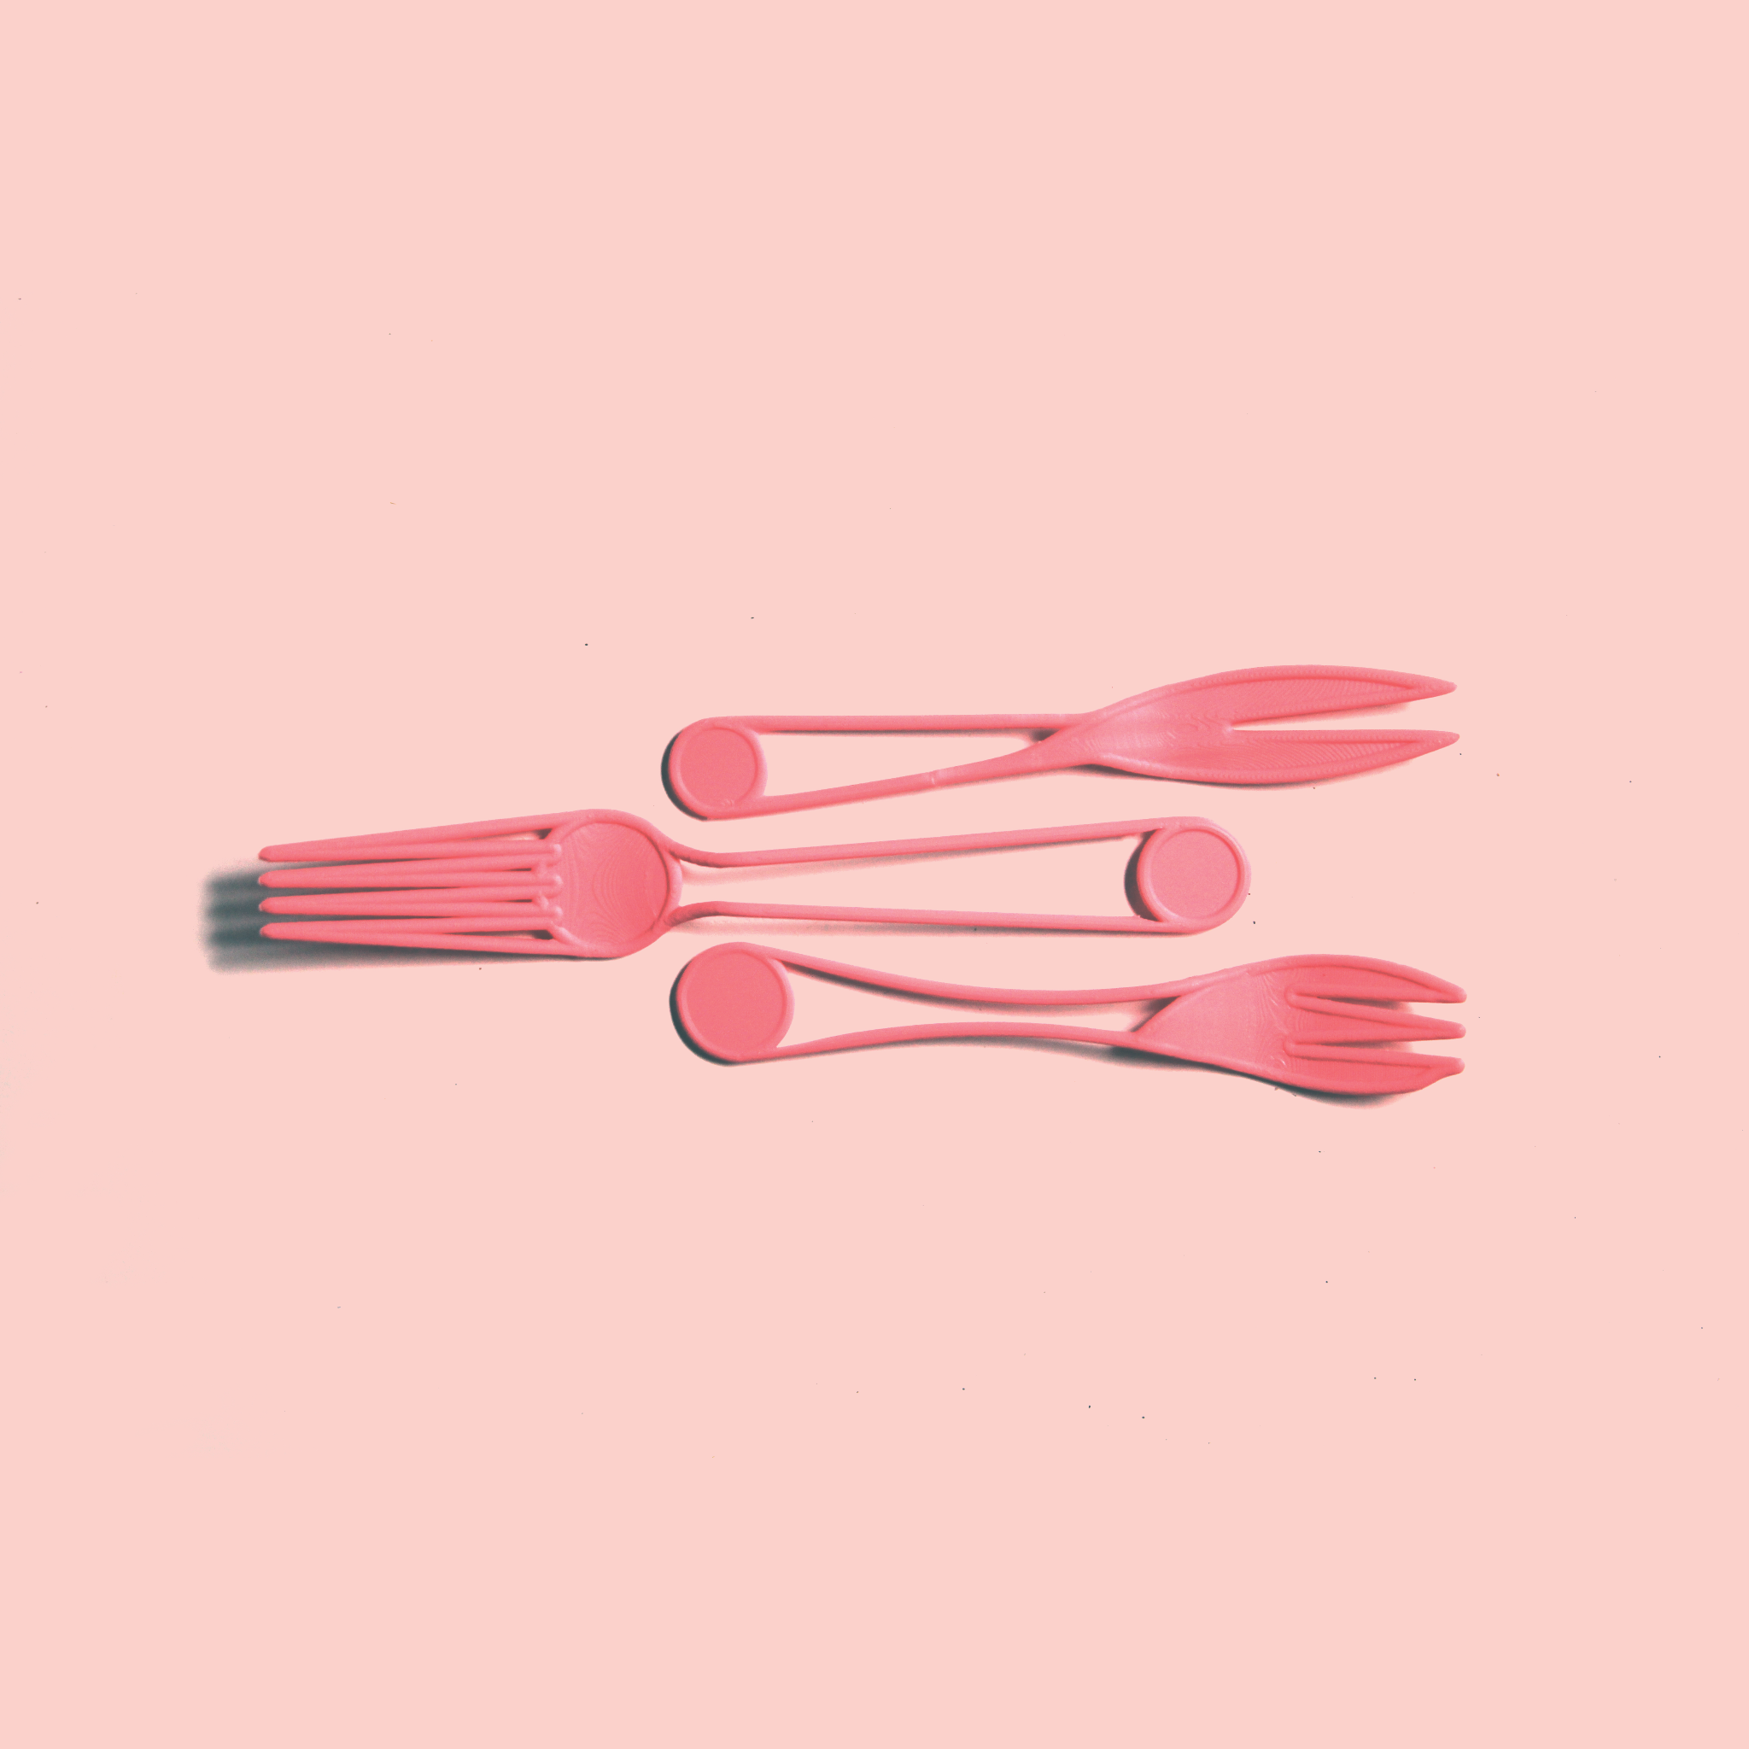

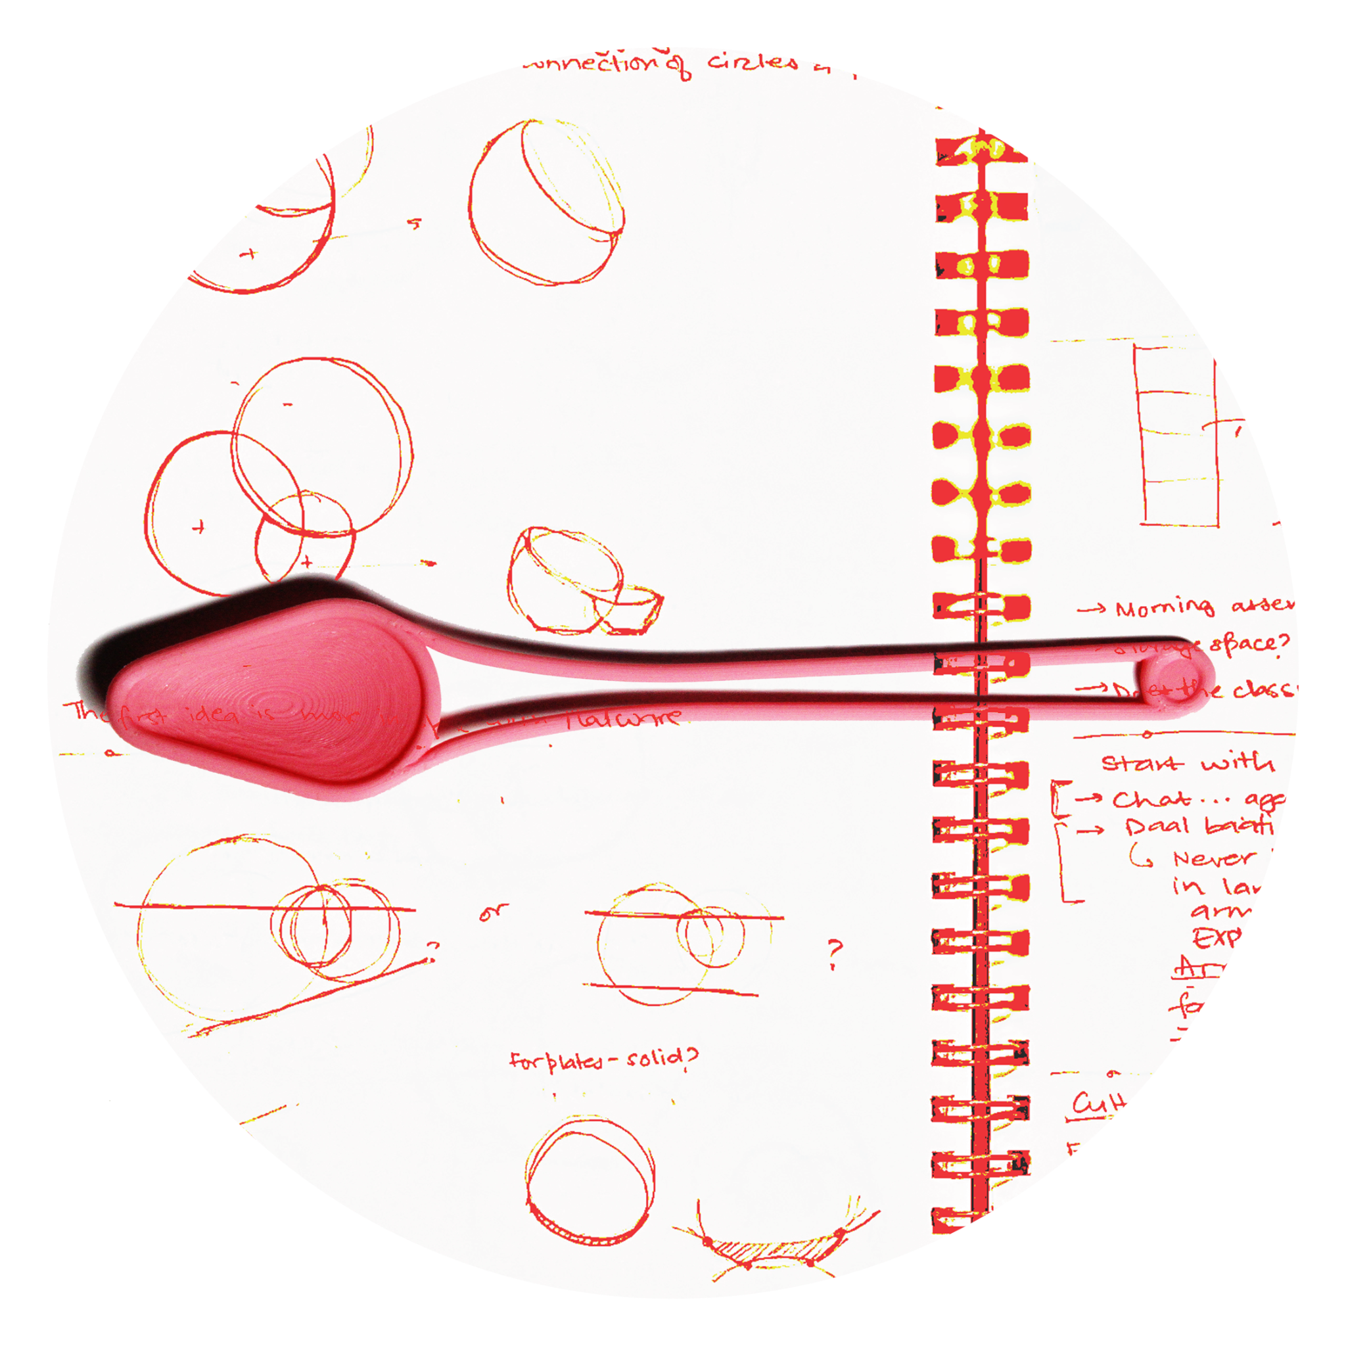
Round Tableware,
At a Round Table.
In a Round Vessel,
Hyperimage Protocols
FA 2025
FA 2025

Slide 5

Hyperimage Protocols
FA 2025
FA 2025

Slide 6
Hyperimage Protocols
FA 2025
FA 2025

Slide 7
Hyperimage Protocols
FA 2025
FA 2025

Slide 8
Incremental Zoning:
https://sps249.github.io/Website-1/
Hyperimage Protocols
FA 2025
FA 2025

Slide 9
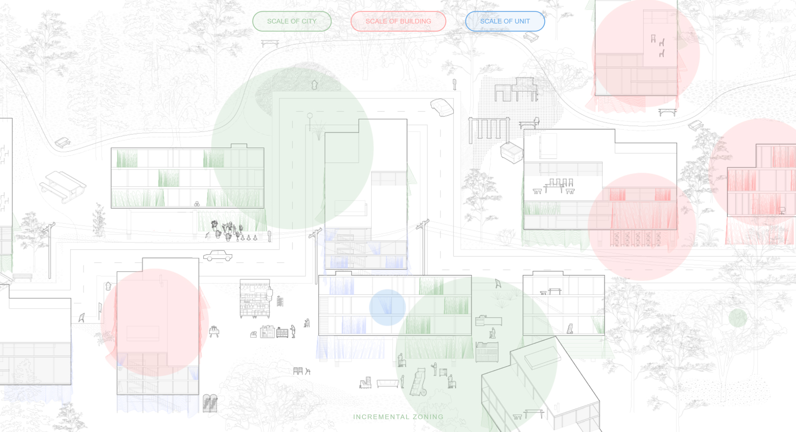
Hyperimage Protocols
FA 2025
FA 2025

Slide 10
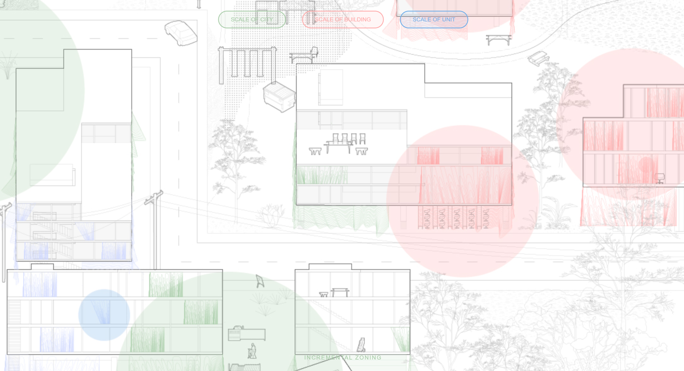
Hyperimage Protocols
FA 2025
FA 2025

Slide 11
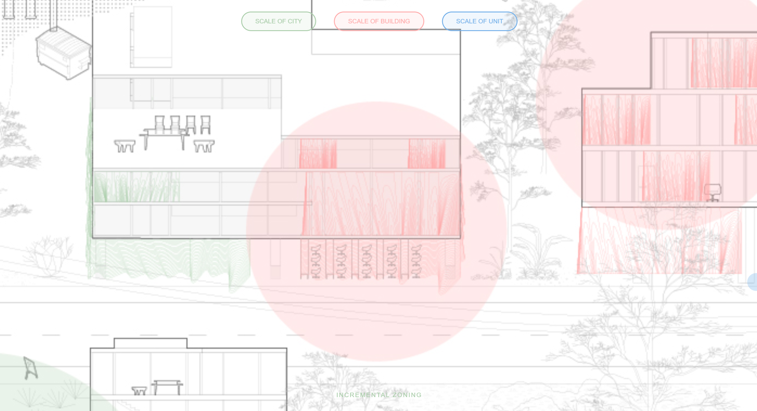
Hyperimage Protocols
FA 2025
FA 2025

Slide 12
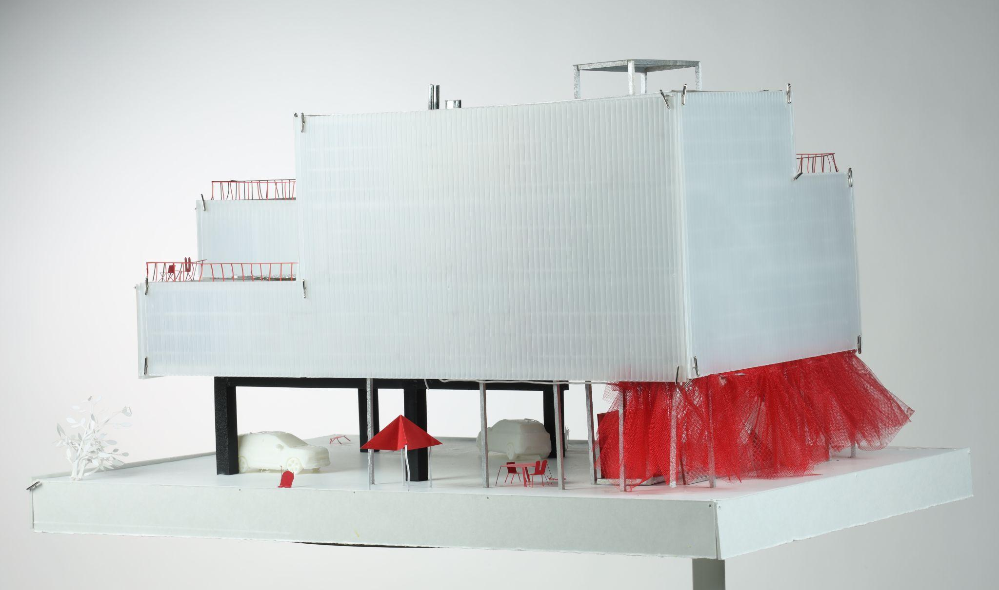
Hyperimage Protocols
FA 2025
FA 2025

Slide 13
Hyperimage Protocols
FA 2025
FA 2025

Slide 14
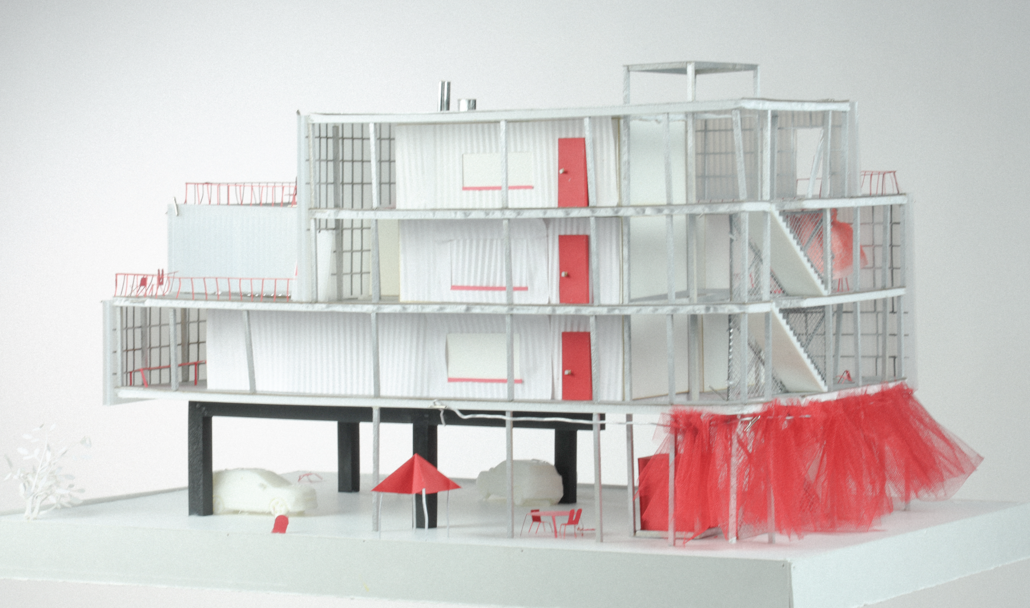
Hyperimage Protocols
FA 2025
FA 2025

Slide 15
ANUNYA + SARA:
Urban Ecotone
https://sara-anunya.github.io/Ecotone/New_Pointcloud/threejs.html
Hyperimage Protocols
FA 2025
FA 2025

Slide 16
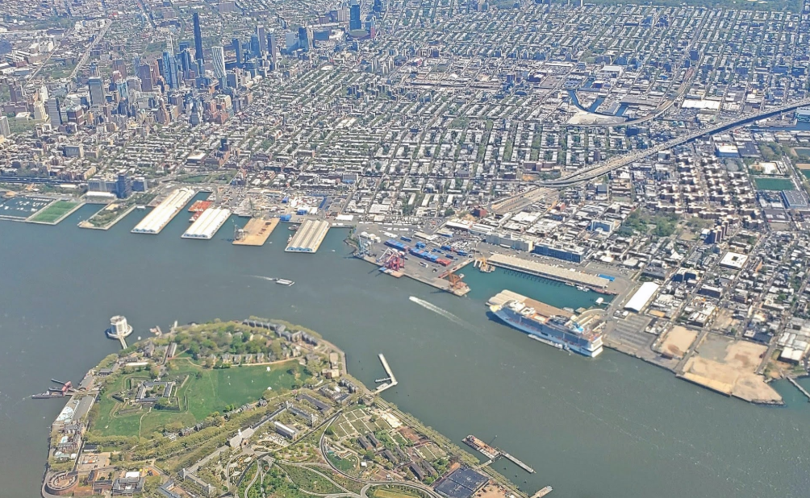
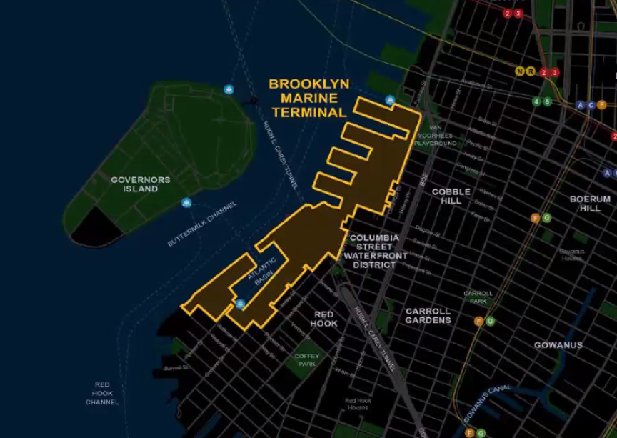
SITE CONTEXT:
Hyperimage Protocols
FA 2025
FA 2025

Slide 17
Create a site-wide ecotone/a productive meeting ground for urban and marine habitats, and embrace, rather than tussle with, environmental forces and other species.
Hyperimage Protocols
FA 2025
FA 2025

Slide 18
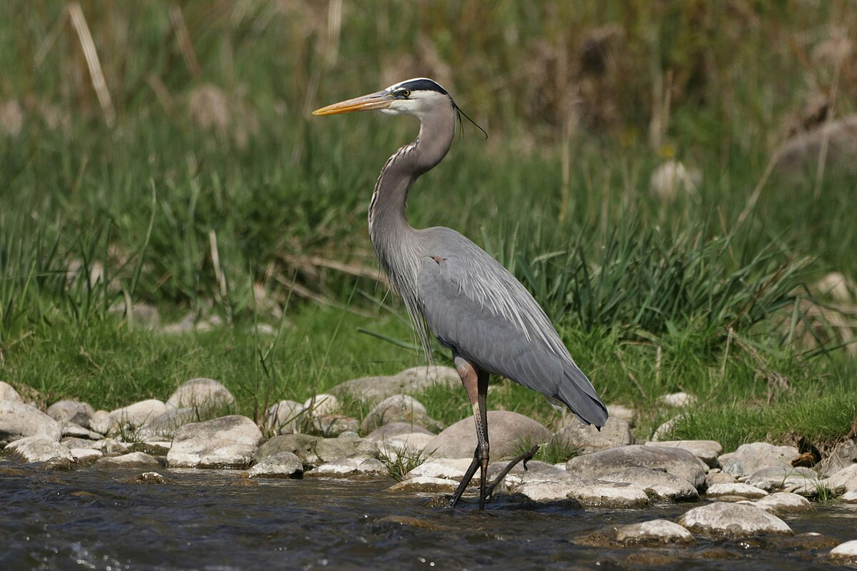
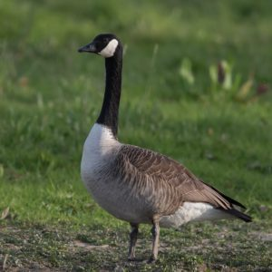
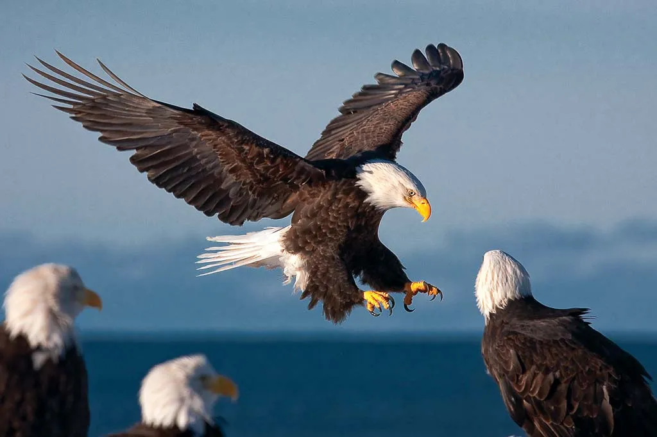
SITE CONTEXT:
Great Blue Heron + 9 other species of herons
Canada Geese
Bald eagles + Other birds of Prey
Wetland birds that need shallow waters and grass.
On the Atlantic flyway (Feb-October), need open grasses and shallow slopes
On the Atlantic flyway (Feb-October), need open grasses and shallow slopes
Hyperimage Protocols
FA 2025
FA 2025

Slide 19
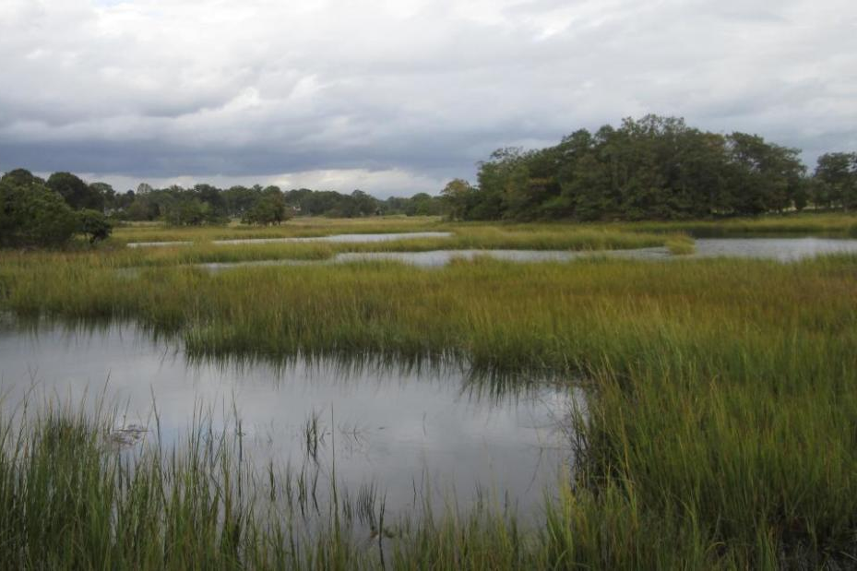
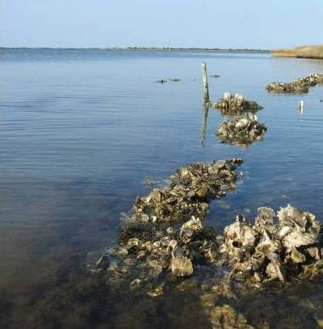
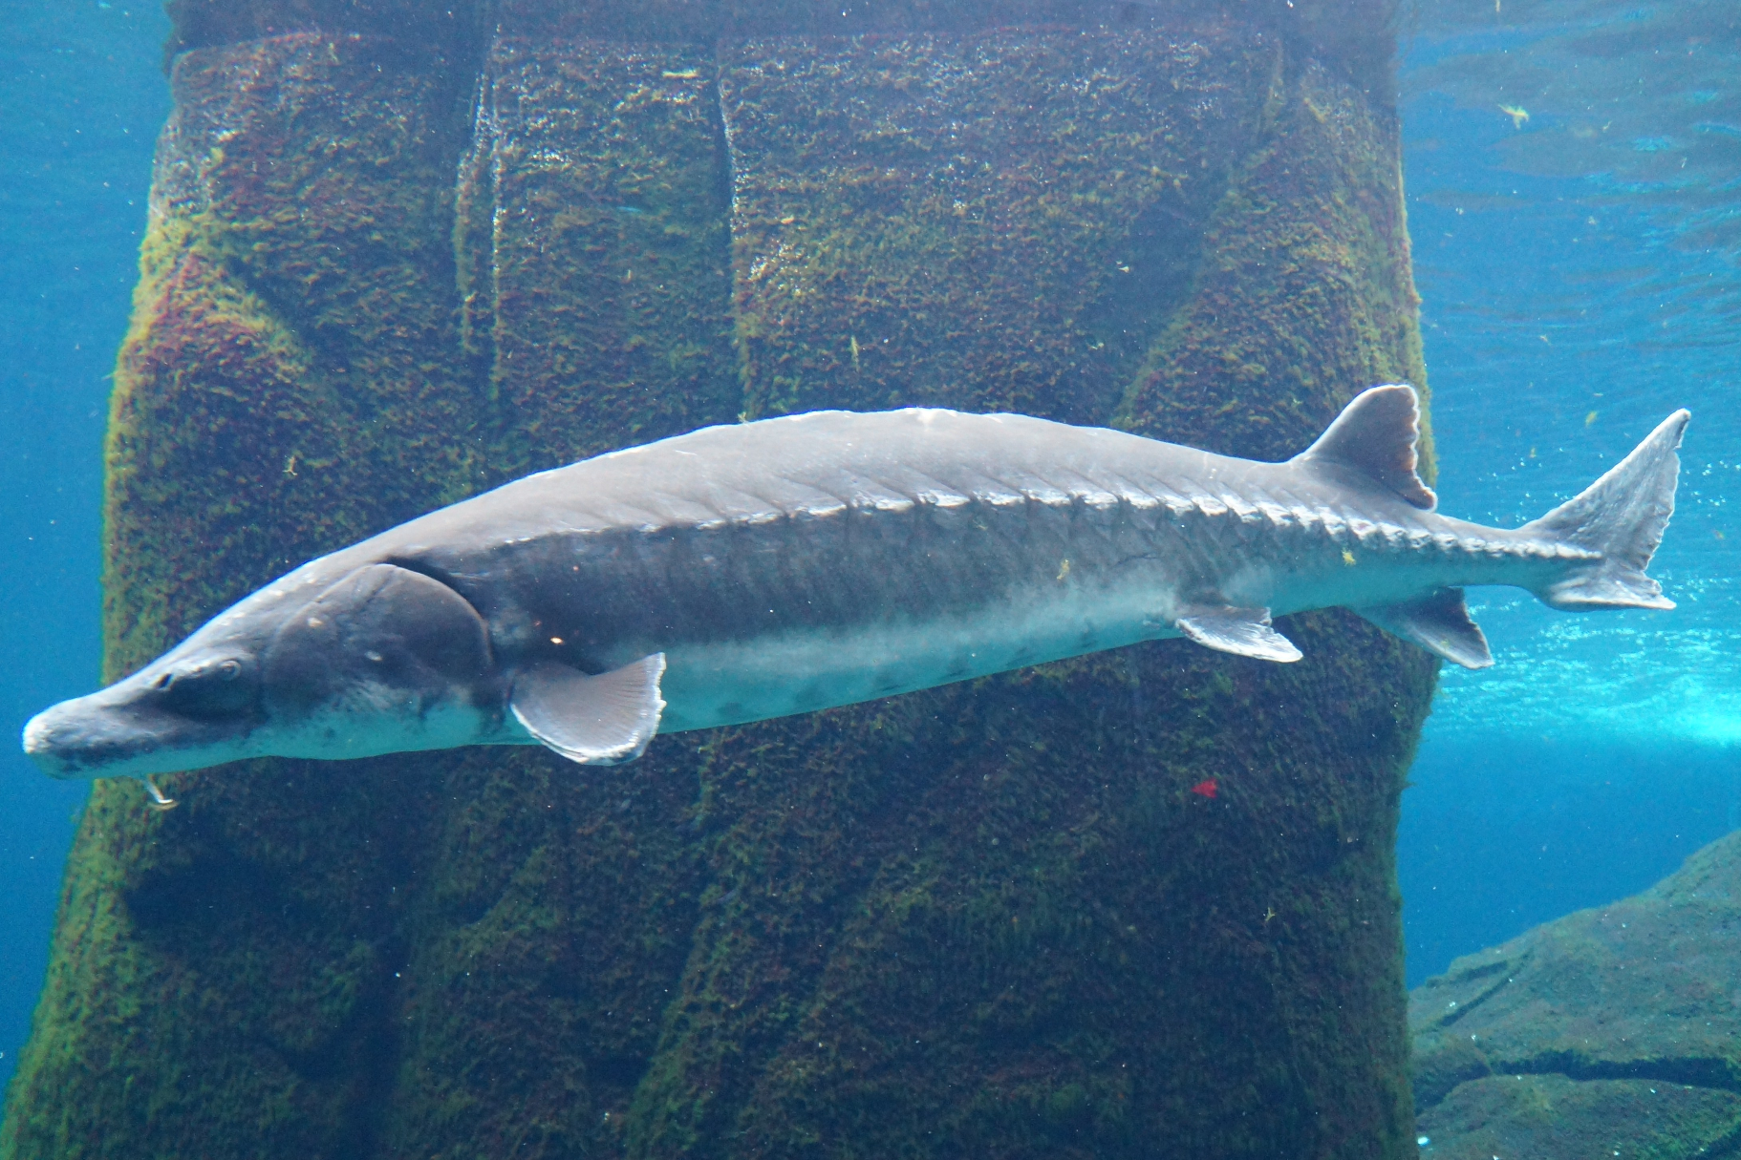
SITE CONTEXT:
Wetland/Marsh with eelgrass beds and cordgrasses (varying upon tides and elevations)
Oysters make amazing reefs, and filter about 50 gallons of water/oyster a day!
Sturgeon populations in the Hudson are bottlenecked. They need rocky bottoms (towards the marine end)for spawning and good currents for eggs to oxygenate
Hyperimage Protocols
FA 2025
FA 2025

Slide 20
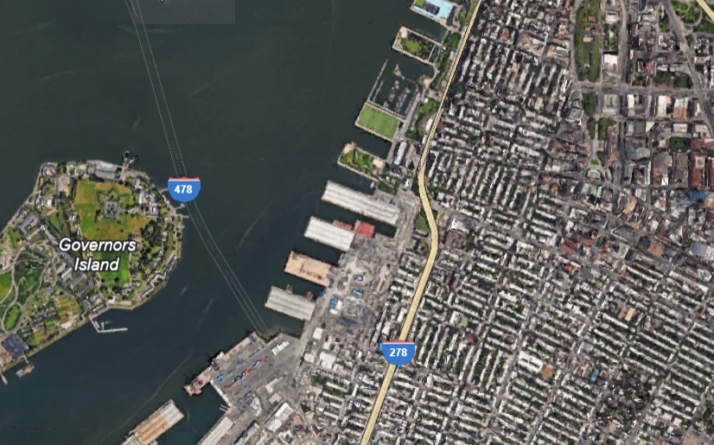
Hyperimage Protocols
FA 2025
FA 2025

Slide 21
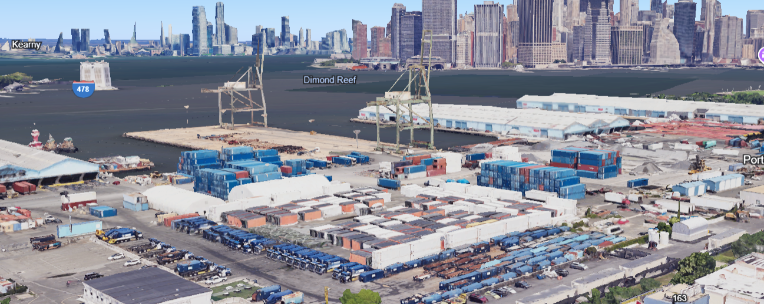
Hyperimage Protocols
FA 2025

Slide 22
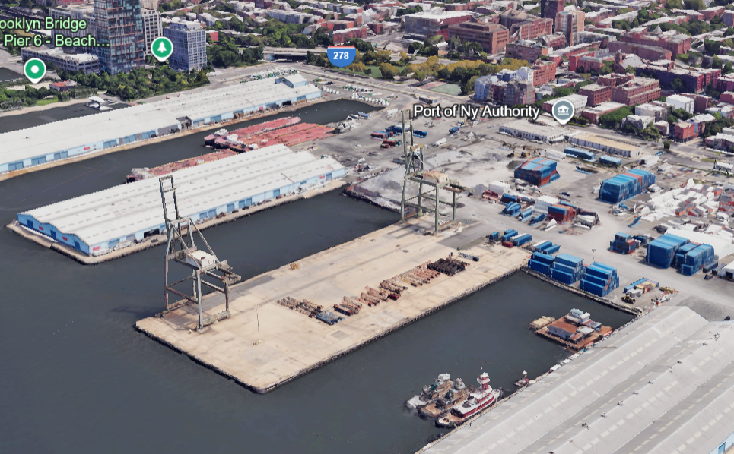
Hyperimage Protocols
FA 2025

Slide 23
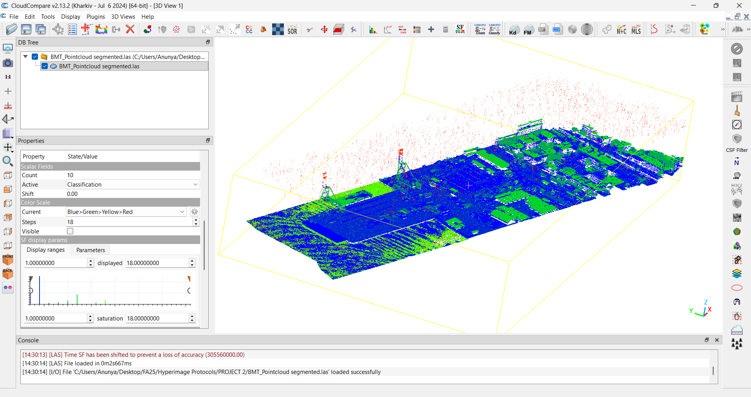
Hyperimage Protocols
FA 2025

Slide 24
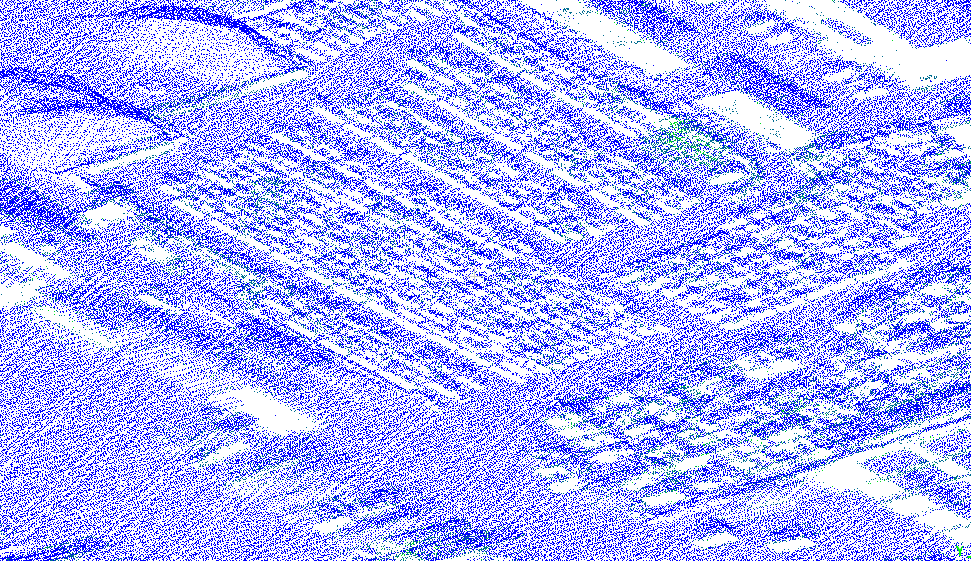
Hyperimage Protocols
FA 2025

Slide 25
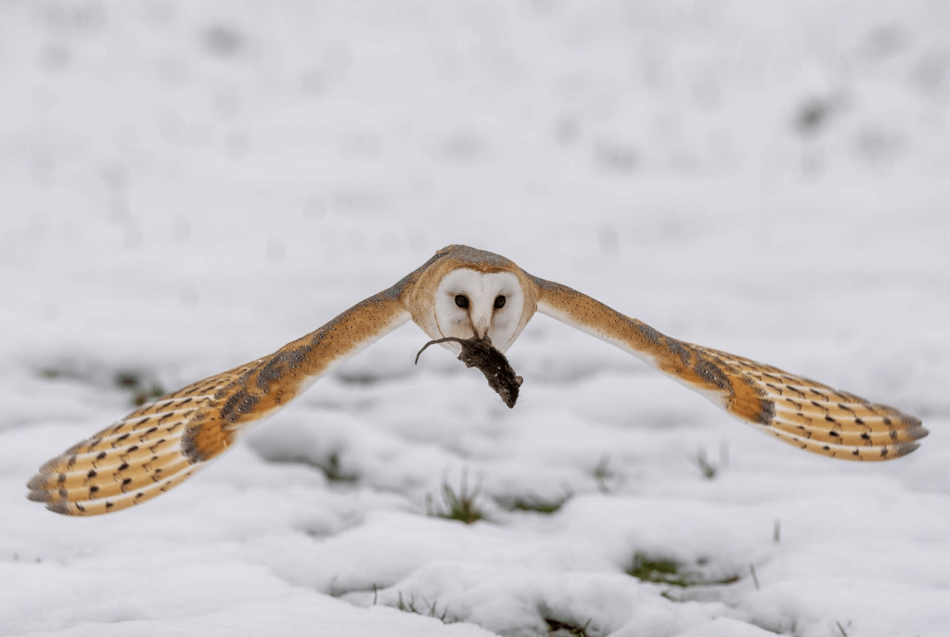
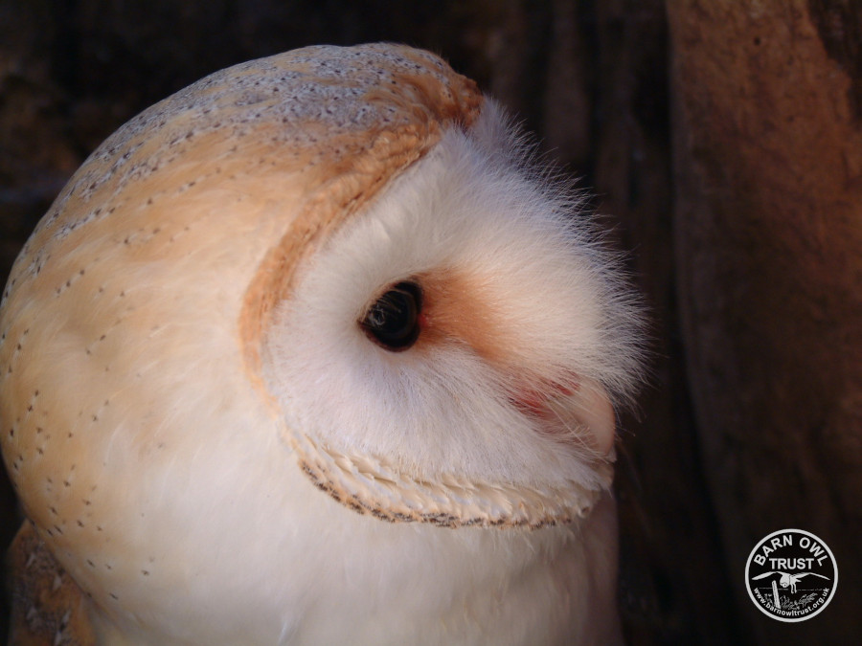
https://www.sciencedirect.com/science/article/pii/S0896627323008930
Hyperimage Protocols
FA 2025
FA 2025

Slide 26
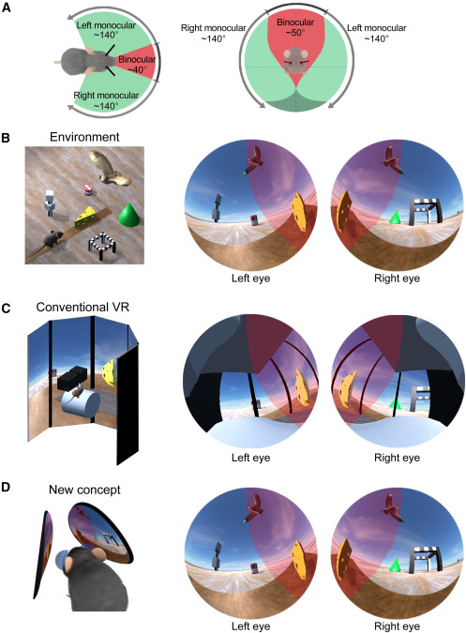
https://www.sciencedirect.com/science/article/pii/S0896627323008930
Hyperimage Protocols
FA 2025
FA 2025

Slide 27
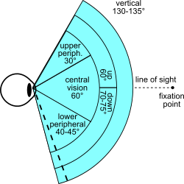
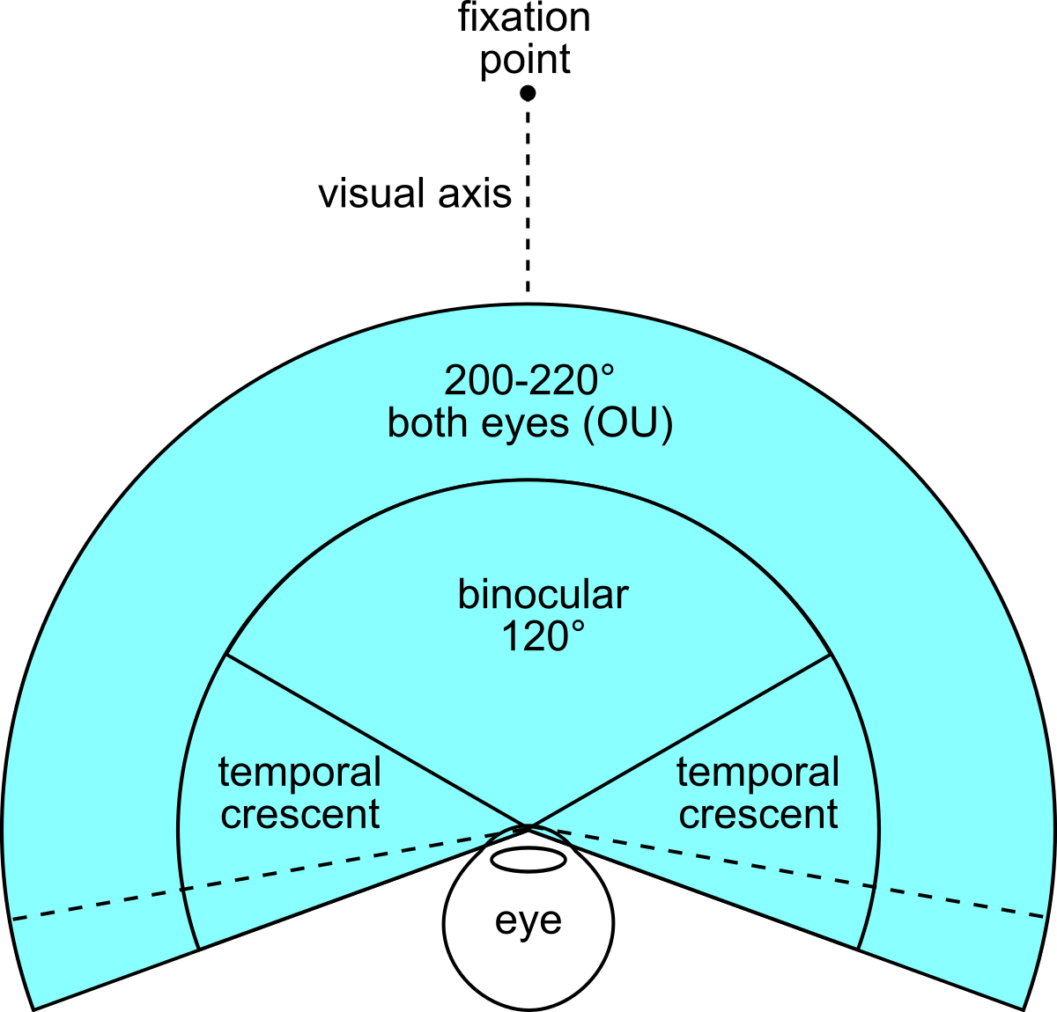
https://en.wikipedia.org/wiki/Field_of_view
Hyperimage Protocols
FA 2025
FA 2025

Slide 28
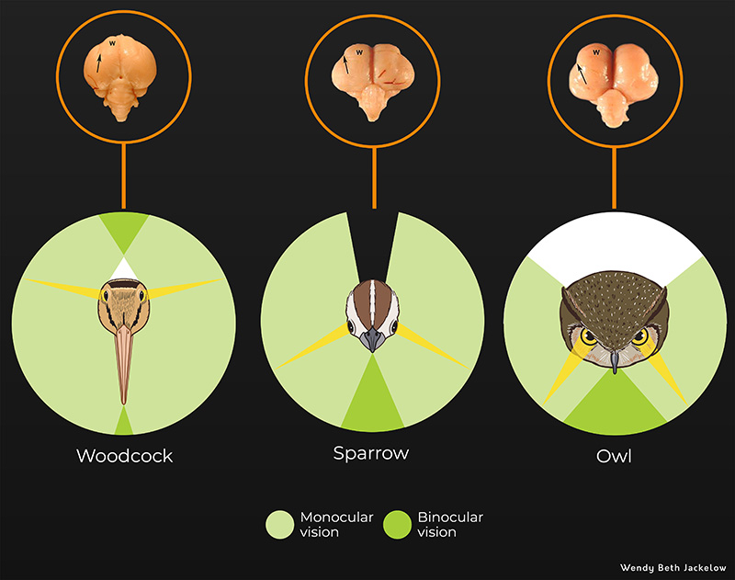
https://www.depts.ttu.edu/museumttu/exhibitions/2019/fear-online/predators-owls.php
Hyperimage Protocols
FA 2025
FA 2025

Slide 29
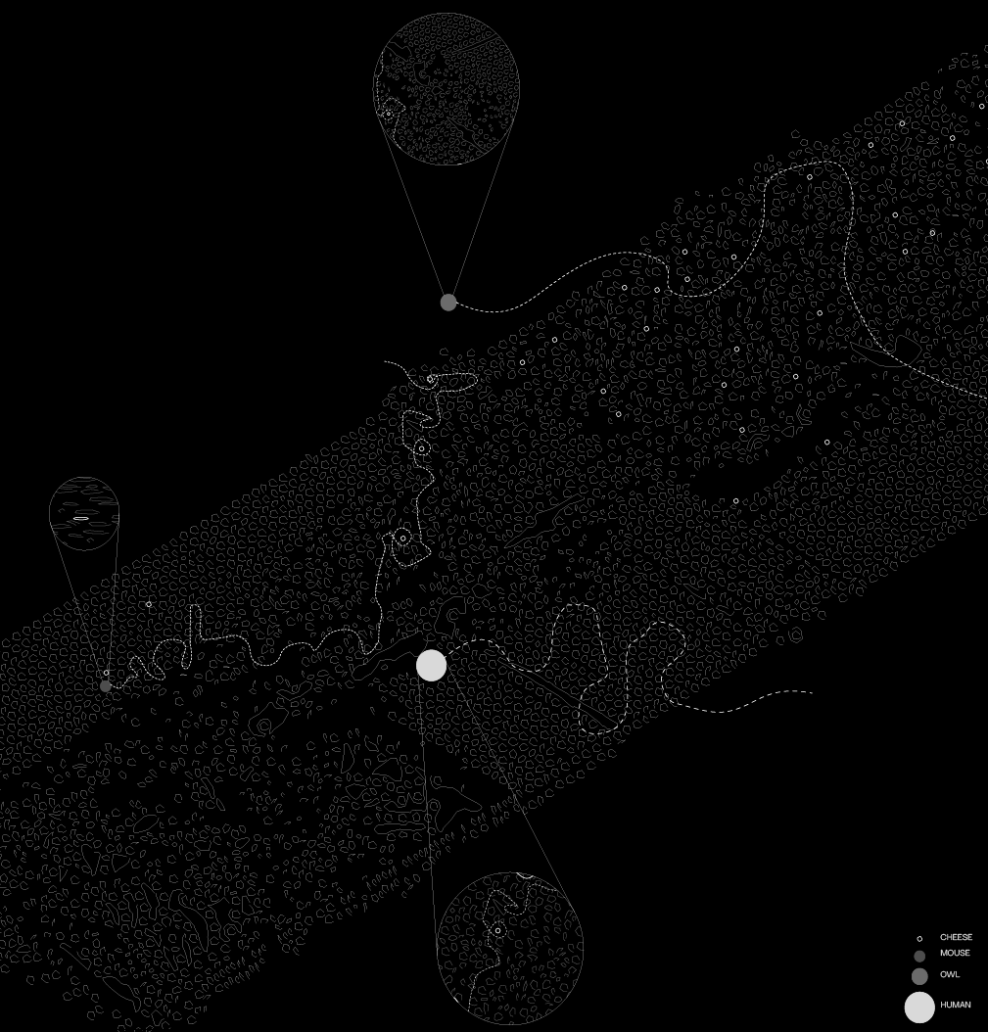
Hyperimage Protocols
FA 2025
FA 2025

Slide 30
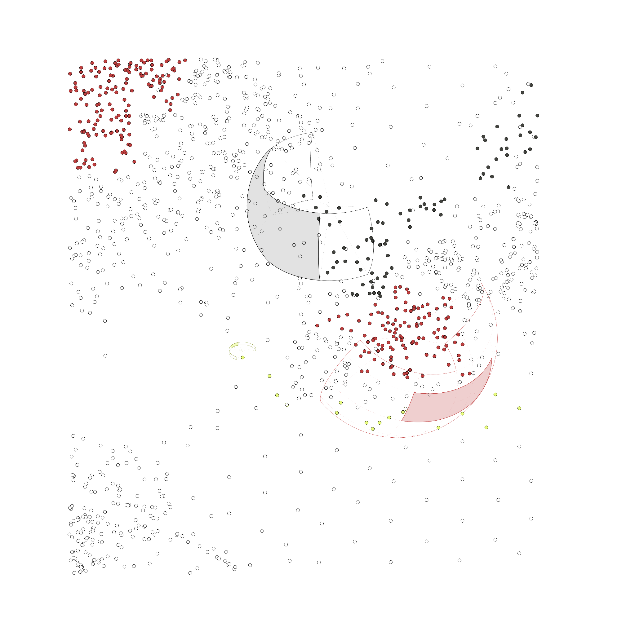
Hyperimage Protocols
FA 2025
FA 2025

Slide 31
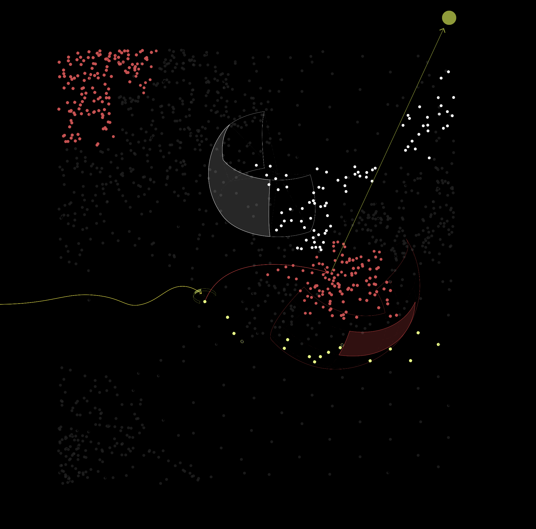
Hyperimage Protocols
FA 2025
FA 2025

Slide 32
Hyperimage Protocols
FA 2025
FA 2025

Slide 33
2
Niche Research Tool
Brooklyn Marine Terminal
Anunya Kasliwal and Sara Shah
Hyperimage Protocols
FA 2025

Slide 34
Create a tool to find Unintentional Plant, Bird, mammal and arthropod Niches in an urban habitat.
Hyperimage Protocols
FA 2025
FA 2025

Slide 35
https://www.inaturalist.org/observations?nelat=40.69664502160009&nelng=-73.98964734969914&subview=map&swlat=40.67627359915789&swlng=-74.01204915939152
Hyperimage Protocols
FA 2025
FA 2025

Slide 36
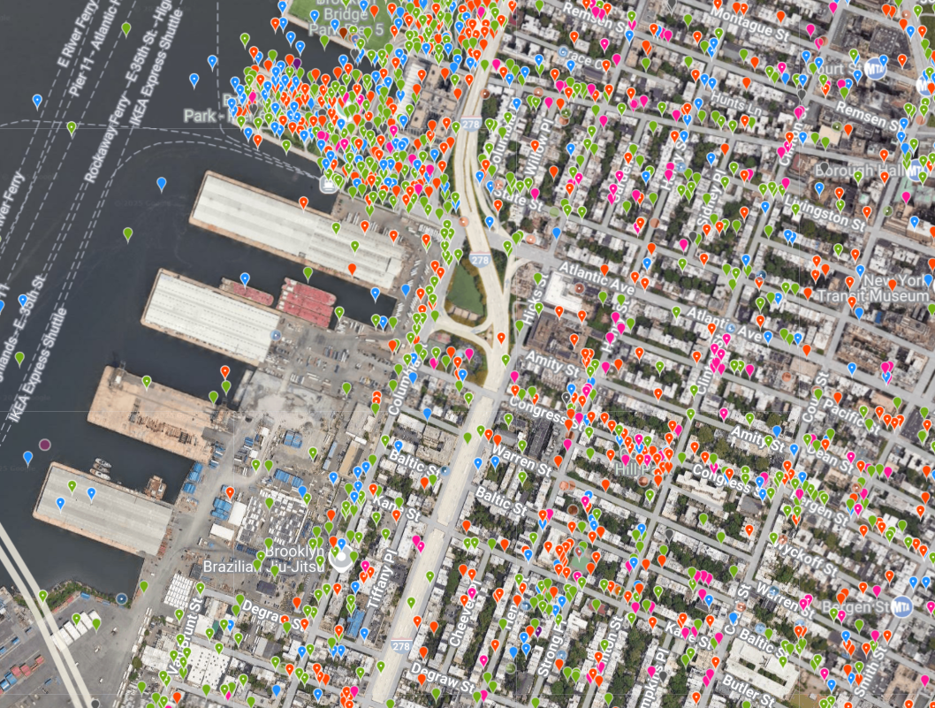
Hyperimage Protocols
FA 2025
FA 2025

Slide 37
Hyperimage Protocols
FA 2025
FA 2025

Slide 38
Hyperimage Protocols
FA 2025
FA 2025

Slide 39
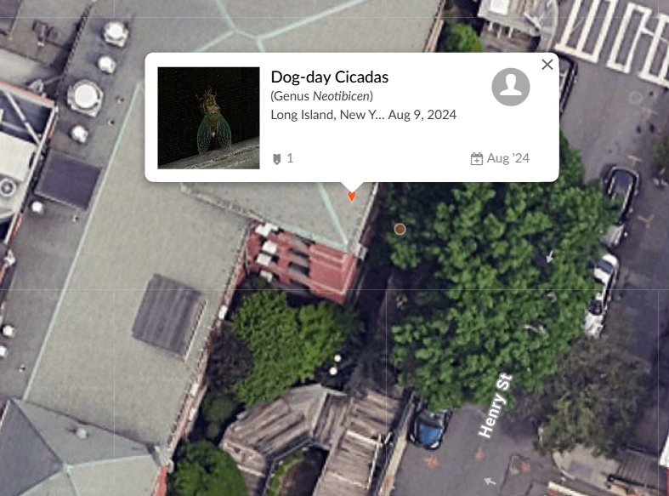
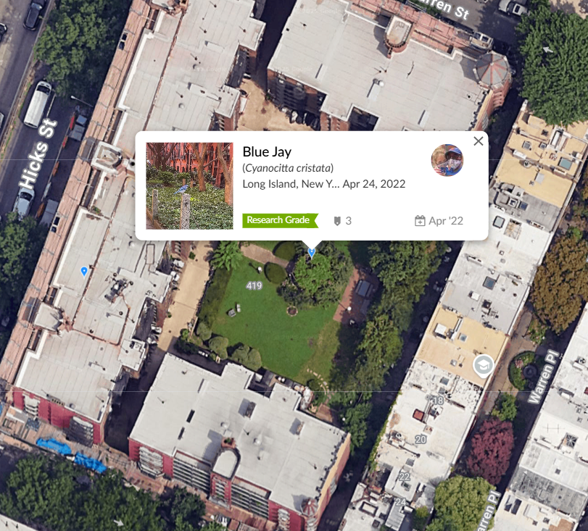
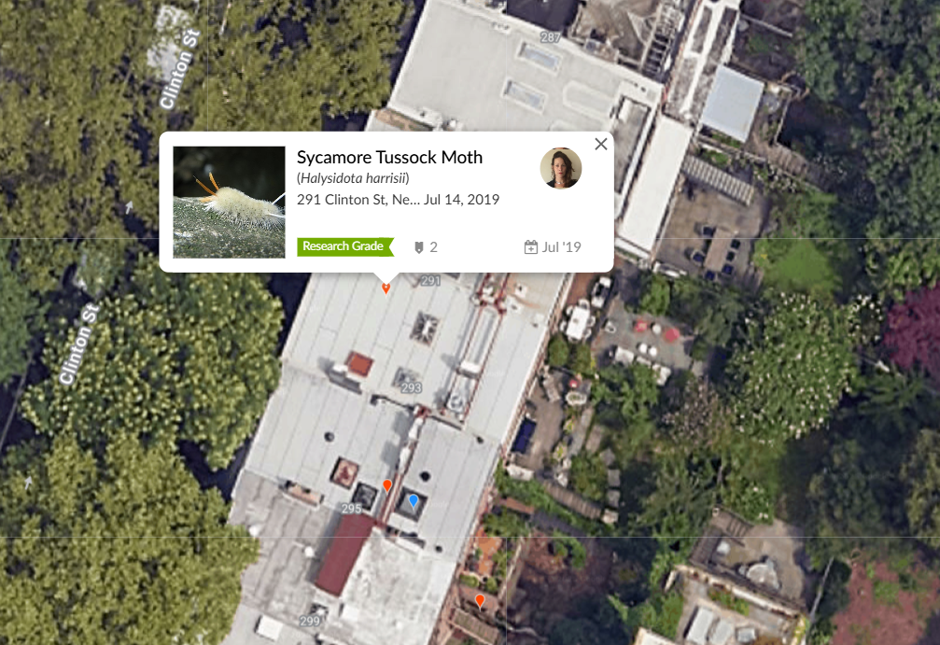
Hyperimage Protocols
FA 2025
FA 2025

Slide 40
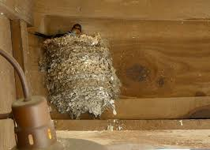
Hyperimage Protocols
FA 2025
FA 2025

Slide 41
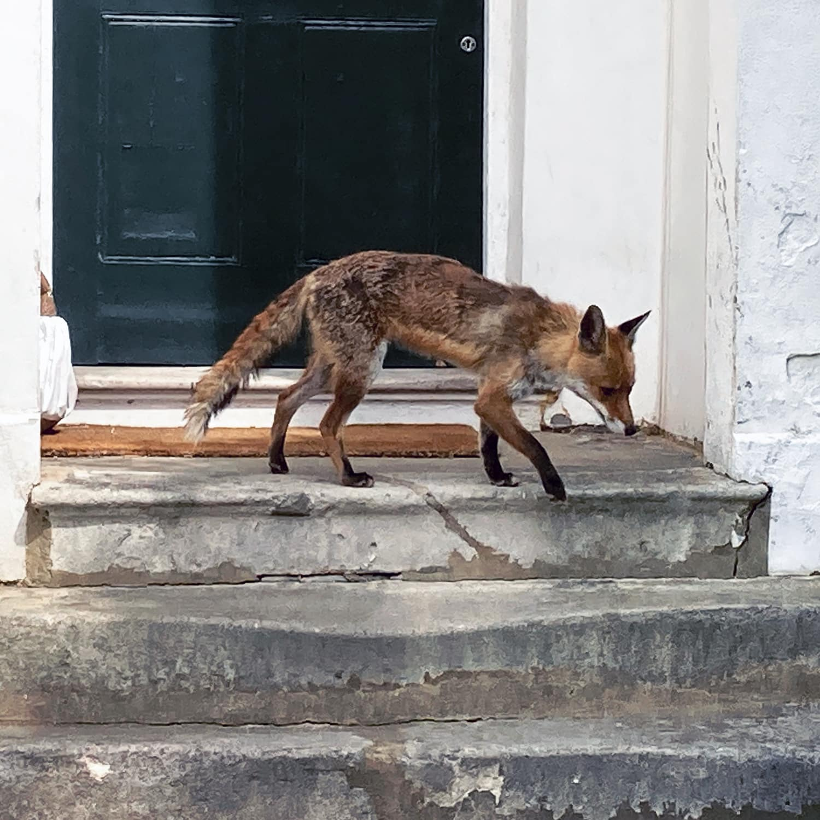
Hyperimage Protocols
FA 2025
FA 2025

Slide 42
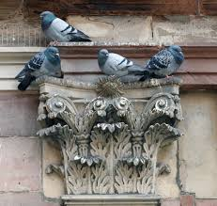
Hyperimage Protocols
FA 2025
FA 2025

Slide 43
What is it doing there?
Hyperimage Protocols
FA 2025
FA 2025

Slide 44
https://www.barnowltrust.org.uk/barn-owl-facts/barn-owl-adaptations/#:~:text=Compared%20with%20most%20birds%2C%20Barn,wings%20supporting%20a%20lightweight%20body).&text=This%20means%20they%20are%20able,the%20slightest%20lift%20(rising%20air).
Hyperimage Protocols
FA 2025
FA 2025

Slide 45
https://www.youtube.com/watch?v=l70UhhNalqA
Hyperimage Protocols
FA 2025
FA 2025

